Slide 1


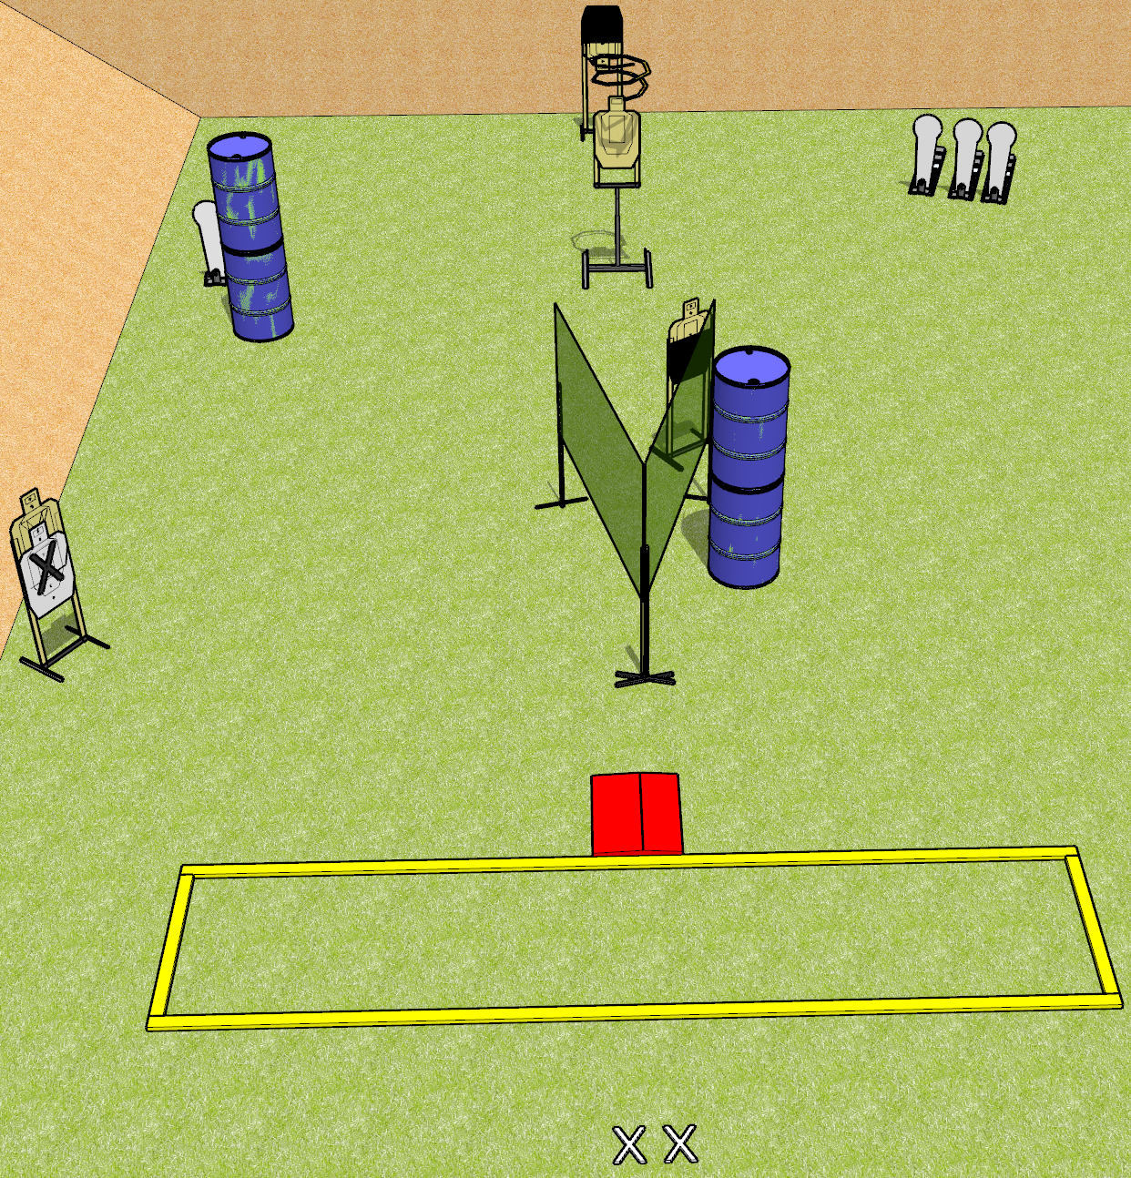
 | Dothan Gun Club – USPSA Match Something Wicked Course Designer : Drew Coleman
START POSITION : Standing with both heels covering X’s, wrists below belt
GUN READY CONDITION : Pistol unloaded and holstered. PCC unloaded, held in both hands with buttstock on belt. |  | SCORING: Comstock, 12 rounds TARGETS: 4 paper, 4 Steel SCORED HITS: Best 2 on paper, steel until down START-STOP: Audible, last shot RULES: The drop turner is a disappearing target and must be activated before last shot fired (9.9.3).
STAGE PROCEDURE: Engage targets as they become available from within the fault lines.

Slide 2
Something Wicked
Written Stage Briefing
Something Wicked is a 12 round, 60 point, Comstock Short Course. There are four USPSA targets and four Colt Speed Steel targets. The best two hits per target will score. The drop turner target is a disappearing target. Steel must fall to score. The start signal is audible.
Handgun start position is standing with both heels covering X’s, wrists below belt. Handgun is unloaded and holstered.
PCC start position is standing with both heels covering X’s, unloaded carbine held with both hands, buttstock on belt.
Upon start signal, engage targets as they become available from within the fault lines. The drop turner target must be activated before the last shot fired, per USPSA rule 9.9.3.

